Slide 1
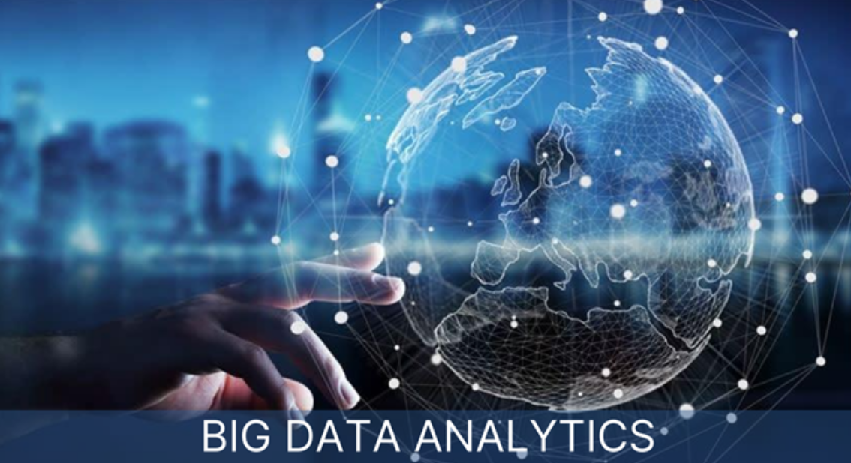
Fundamentals of Bigdata Analytics and Business Intelligence(BI)
Chapter 1 : Foundation of Data Analytics & Python Programming

Slide 2
Def:
Data Analytics is the process of examining data sets to draw conclusions about the information they contain, often with specialized systems and software.
Data Analytics isn't new, but its scale is. It started with simple reports, but the explosion of cheap computing and data storage pushed us into the current era of Big Data. The concept is simple: moving from gut-feeling or experience-based decisions to fact-based management using data and rigorous analysis. This discipline is now core to strategic decision-making in every sector."

Slide 3
The Analytical Imperative: From Data to Decisions
Introduction & Concept: Fact-based management using data, statistics, and models to drive decisions.
Evolution: Shift from traditional Reporting (What happened?) to advanced Predictive & Prescriptive modeling (What will happen? What should we do?).
Started with simple reporting (late 20th century) →advanced to BI/Data Warehousing →current era of Big Data and AI-driven insights.
Scopes: Pervasive across all business functions (Marketing, Finance, Operations, HR) and industries (Healthcare, sports, Retail, Government).
The Big Picture: Big Data Analytics is the infrastructure and process; Business Intelligence (BI) is the output and presentation layer.

Slide 4
Cont..
In the modern business landscape, we are witnessing a dramatic shift, where operational decisions are moving away from traditional reliance on intuition or simple experience toward a system of fact-based management.
At the heart of this transformation is Data Analytics, which we define as the extensive use of data, statistical methodologies, and quantitative models to generate actionable insights.
This field has exploded in relevance due to two major factors: the rise of affordable cloud computing and the massive scale of data acquisition, which ushered in the 'Big Data' era, making sophisticated analysis technically and economically feasible for virtually any organization.

Slide 5
Cont..
Consequently, the scope of data analytics is massive and essential across every domain, from optimizing complex logistical routes in a global supply chain (Operations) to accurately predicting which customers are most likely to leave the service (Marketing).“
What is Data?
The quantities, characters, or symbols on which operations are performed by a computer, which may be stored and transmitted in the form of electrical signals and recorded on magnetic, optical, or mechanical recording media.

Slide 6
Define Data, characteristics of data?
Data is a collection of details in the form of either figures or texts or symbols, or descriptions etc.
Data contains raw figures and facts. Information unlike data provides insights analyzed through the data collected.
Data has 3 characteristics:
1. Composition: The composition of data deals with the structure of data, i.e; the sources of data, the granularity/detail/precision, the types and nature of data as to whether it is static or real time streaming.
2. Condition: The condition of data deals with the state of data, i.e; “Can one use this data as is for analysis?” or “Does it require cleaning for further enhancement and enrichment?” data?”
3. Context: The context of data deals with “Where has this data been generated?”. “Why was this data generated?”, “How sensitive is this data?”, “What are the events associated with this”.

Slide 7
What is digital data? Explain different types of digital data.
The data that is stored using specific machine language systems which can be interpreted by various technologies is called digital data.
Eg. Audio, video or text information
Digital Data is classified into three types:
1. Structured Data:- This is the data which is in an organized form, for example in rows and columns. No of rows called Cardinality and No of columns called Degree of a relation Sources: Database, Spread sheets, OLTP systems.
2. Semi-Structured Data:
This data which doesn’t conform to a data model but has some structure. Metadata for this data is available but is not sufficient. It has inconsistent structure.
Sources: XML, JSON, E-mail, self describing (label/value pairs)

Slide 8
Cont..
3. Unstructured Data:
This is the data which does not conform to a data model or is not in a form which can be used easily by a computer program.
About 80–90% data of an organization is in this format.
Sources: memos, chat-rooms, PowerPoint presentations, images, videos, letters, researches, white papers, body of an email, etc.
Characteristics:
Does not confirm to any data model
Can’t be stored in the form of rows and columns
Not in any particular format or sequence
Not easily usable by the program
Doesn’t follow any rule or semantics

Slide 9
Cont..
Challenges:
Storage space: Sheer volume of unstructured data and its unprecedented growth makes it difficult to store. Audios, videos, images, etc. acquire huge amount of storage space
Scalability: Scalability becomes an issue with increase in unstructured data
Retrieve information: Retrieving and recovering unstructured data are cumbersome
Security: Ensuring security is difficult due to varied sources of data (e.g. e-mail, web pages)
Update/delete: Updating, deleting, etc. are not easy due to the unstructured form
Indexing and Searching: Indexing becomes difficult with increase in data.
Searching is difficult for non-text data
Interpretation: Unstructured data is not easily interpreted by conventional search algorithm
Tags: As the data grows it is not possible to put tags Manually
Indexing: Designing algorithms to understand the meaning of the document and then tag or index them accordingly is difficult.

Slide 10
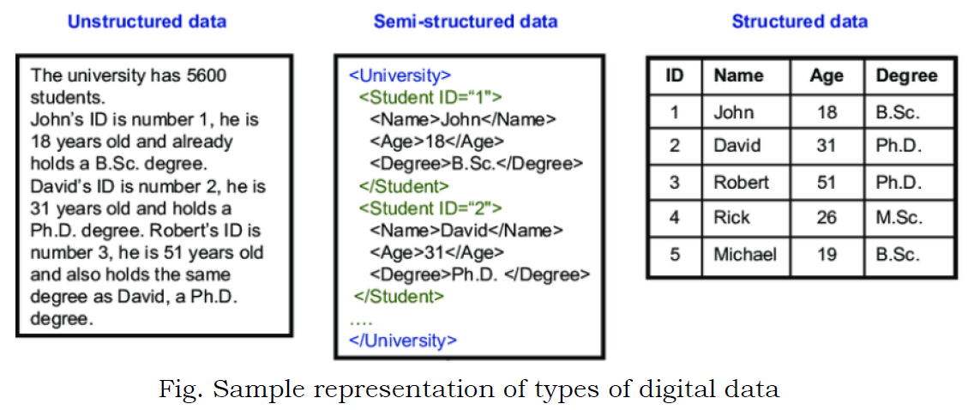
Cont..

Slide 11
Cont..
Dealing with Unstructured data:
Data Mining: Knowledge discovery in databases, popular Mining algorithms are Association rule mining, Regression Analysis, and Collaborative filtering
Natural Language Processing: It is related to HCI. It is about enabling computers to understand human or natural language input.
Text Analytics: Text mining is the process of gleaning high quality and meaningful information from text. It includes tasks such as text categorization, text clustering, sentiment analysis and concept/entity extraction.
Noisy text analytics: Process of extraction structured or semi-structured from noisy unstructured data such as chats, blogs, wikis, emails, Spelling mistakes, abbreviations, uh, hm, non standard words.

Slide 12
Define Big Data.
What is Big Data?
Big Data is a collection of data that is huge in volume, yet growing exponentially with time. It is a data with so large size and complexity that none of traditional data management tools can store it or process it efficiently. Big data is also a data but with huge size.
Big data is not merely a data, rather it has become a complete subject, which involves various tools, techniques and frameworks.

Slide 13
Cont..
What Comes Under Big Data?
Big data involves the data produced by different devices and applications. Given below are some of the fields that come under the umbrella of Big Data.
Black Box Data: It is a component of helicopter, airplanes, and jets, etc. It captures voices of the flight crew, recordings of microphones and earphones, and the performance information of the aircraft.
Social Media Data: Social media such as Facebook and Twitter hold information and the views posted by millions of people across the globe.
Stock Exchange Data: The stock exchange data holds information about the ‘buy’ and ‘sell’ decisions made on a share of different companies made by the customers.
Power Grid Data: The power grid data holds information consumed by a particular node with respect to a base station.
Transport Data: Transport data includes model, capacity, distance and availability of a vehicle.
Search Engine Data: Search engines retrieve lots of data from different databases.

Slide 14
Benefits of Big Data
Big data is really critical to our life and its emerging as one of the most important technologies in modern world. Follow are just few benefits which are very much known to all of us:
Using the information kept in the social network like Facebook, the marketing agencies are learning about the response for their campaigns, promotions, and other advertising mediums.
Using the information in the social media like preferences and product perception of their consumers, product companies and retail organizations are planning their production.
Using the data regarding the previous medical history of patients, hospitals are providing better and quick service.
Traditional customer feedback systems are getting replaced by new systems designed with Big Data technologies. In these new systems, Big Data and natural language processing technologies are being used to read and evaluate consumer responses.

Slide 15
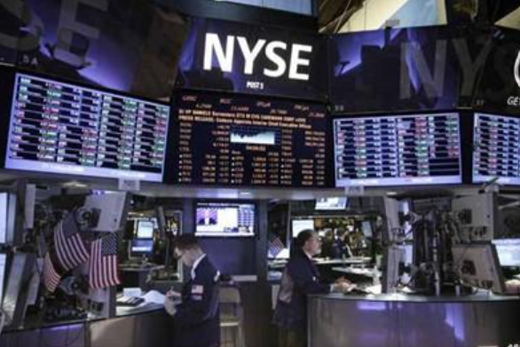


What is an Example of Big Data?
The New York Stock Exchange is an example of Big Data that generates about one terabyte of new trade data per day.
Social Media: The statistic shows that 500+terabytes of new data get ingested into the databases of social media site Facebook, every day. This data is mainly generated in terms of photo and video uploads, message exchanges, putting comments etc.
A single Jet engine can generate 10+terabytes of data in 30 minutes of flight time. With many thousand flights per day, generation of data reaches up to many Petabytes.

Slide 16
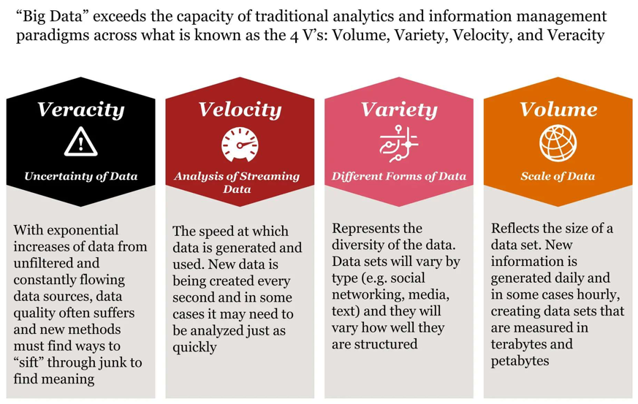
Characteristics of Big Data

Slide 17
Cont..
1. Volume: It refers to the amount of the data. The size of the data is being increased from Bits to Yottabytes.
Bits-> Bytes-> KBs-> MBs-> GBs-> TBs-> PBs-> Exabytes-> Zettabytes-> Yottabytes
There are different sources of data like doc, pdf, YouTube, a chat conversation on internet messenger, a customer feedback form on an online retail website, CCTV coverage and weather forecast.
The sources of Big data:
1. Typical internal data sources: data present within an organization’s firewall.
Data storage: File systems, SQL (RDBMSs- oracle, MS SQL server, DB2, MySQL, PostgreSQL etc.) NoSQL, (MangoDB, Cassandra etc) and so on.
Archives: Archives of scanned documents, paper archives, customer correspondence records, patient’s health records, student’s admission records, student’s assessment records, and so on.
2. External data sources: data residing outside an organization’s Firewall.
Public web: Wikipedia, regulatory, compliance, weather, census etc.,
3. Both (internal + external sources)
Sensor data, machine log data, social media, business apps, media and docs.

Slide 18
Cont..
2. Variety: Variety deals with the wide range of data types and sources of data. Structured, semi-structured and Unstructured.
Structured data: From traditional transaction processing systems and RDBMS, etc.
Semi-structured data: For example, Hypertext Markup Language (HTML), Extensible Markup Language (XML).
Unstructured data: For example, unstructured text documents, audios, videos, emails, photos, PDFs , social media, etc.
3. Velocity: It refers to the speed of data processing. we have moved from the days of batch processing to Real-time processing.
4. Veracity: Veracity refers to biases, noise and abnormality in data. The key question is “Is all the data that is being stored, mined and analyzed meaningful and relevant to the problem under consideration”.

Slide 19
Data Reliability & Validity, Problem Solving with Analytics
Data Quality and The Analytical Mindset
Data Reliability: The consistency and stability of data collection. Does the measurement tool produce the same result under the same conditions?
Data Validity: The accuracy of the measurement. Does the data actually measure what it is intended to measure?
Problem Solving with Analytics: Framework for defining the business problem, quantifying it with data, applying models, and implementing solutions.
GIGO: Garbage In, Garbage Out. Low reliability/validity leads to flawed insights and poor decisions.

Slide 20
Data Reliability & Validity, Problem Solving with Analytics
Data Quality and The Analytical Mindset Cont..
Reliable but Invalid: The scale always shows the same wrong number (e.g., 5 lbs too high every time). It's consistent (reliable), but not accurate (invalid)—so your "progress" looks fake.
Neither Reliable nor Valid: It spits out random numbers each weigh-in (e.g., 150 one day, 120 the next). Totally useless for tracking.
We Need Both: For solid analytics or BI decisions, data must be consistent and accurate—otherwise, your insights (like sales forecasts) are off-base.
Super helpful for avoiding "garbage in, garbage out,"
Analytics is not just technical; it's a structured problem-solving approach. It mandates that we clearly state the business objective before diving into data (e.g., "We need to reduce customer churn by 10%," not "Let's look at the customer data").

Slide 21
How is traditional BI environment different from Big data environment?
Traditional BI Environment | Big Data Environment
Data is stored in central server | Data is stored in a distributed file system
Server scales vertically | Distributed file system scales by horizontally.
Analyzes offline or historic data | Analyzes real or streaming data
Supports Structured data only | Supports variety of data ie; structured, semi-structured and unstructured data.

Slide 22
Phases of Analytics in the Business and Data Science Domain
📚 The Data Science Process Pipeline
This is like a step-by-step guide for using data to solve problems. It has two parts: one for business people (focusing on goals) and one for data experts (focusing on the work). They team up to make smart choices.
🔖 Business Part (The Goal-Setting Steps)
These help decide what to fix and how to check if it worked.
Framing the Question: Pick the main business goal and how to measure if it's a win. Example: "How can we sell more? We'll track sales numbers.“
Framing means clearly defining what problem you want to solve, and how you’ll know if you’ve solved it. It’s setting up the question in the right way before you start looking at data.
For example, instead of just saying “Let’s improve sales,” you frame it more specifically: “How can we increase online sales by 10% in the next three months?”
It’s like choosing your goal and deciding what success looks like—makes the rest of the analysis much easier.

Slide 23
Phases of Analytics in the Business and Data Science Domain
📚 The Data Science Process Pipeline
Hypothesis Generation: Come up with ideas based on data about why something's wrong or how to fix it. Example: "Maybe customers leave because prices are too high—let's check the data."
Action & Decision: Use the data findings to make changes and see if they help. Example: Lower prices, then watch if sales go up.

Slide 24
Phases of Analytics in the Business and Data Science Domain
📚 The Data Science Process Pipeline Cont..
🔖 Data Science Part (The OSEMN Steps)
OSEMN is a cycle for handling data: Get it, clean it, look at it, build tools with it, and share it. (O = Obtain, S = Scrub, E = Explore, M = Model, N = Narrate.)
Obtain: Get the data from places like files, websites, or databases. Example: Pull customer info from a company's records.
Scrub: Clean and fix the data so it's neat and ready to use. This means removing junk, fixing mistakes, and mixing different types together. It takes most of the time!
Explore: Look closely at the data to find patterns. Use charts and simple math to understand it. Example: "Sales are higher on weekends—why?"
Model: Building the predictive or prescriptive tool. Create tools or predictions from the data. Example: Build a simple program that guesses future sales.
Narrate: Communicating results. Tell others what you found in an easy way, like with pictures or reports. Example: Make a colorful chart for bosses to see the key points.

Slide 25
Phases of Analytics in the Business and Data Science Domain
📚 The Data Science Process Pipeline Cont..
The key? Business sets the goals (the "what"), data folks do the work (the "how"). Together, they turn data into real help for decisions, like in business reports or apps.
Emphasize the Scrub/Preparation phase, which often takes 70-80% of a data scientist's time: extracting, cleansing, consolidating, and transforming data from diverse, heterogeneous sources (like SQL, NoSQL, and flat files) into a single, usable enterprise data warehouse or structure.
The Narrate phase is where we build BI portals and visualizations to analyze data, generating information and knowledge for informed decisions.

Slide 26
Descriptive, Predictive, and Prescriptive Analytics
The Three Levels of Analytical Insight
1. Descriptive Analytics (Looking at the Past)
What happened?
Uses things like dashboards and reports to show past results.
Example: Checking last year’s sales numbers or viewing a summary of customer visits.
2. Predictive Analytics (Looking at the Future)
What will happen?
Uses math, statistics, and machine learning to guess what might happen next.
Example: Forecasting next month’s revenue or predicting which customers might leave soon.

Slide 27
Descriptive, Predictive, and Prescriptive Analytics
The Three Levels of Analytical Insight Cont..
3. Prescriptive Analytics (Taking Action)
⦁ What should we do?
⦁ Uses smart algorithms to suggest the best actions to take.
⦁ Example: Finding the fastest delivery route for a truck, or setting product prices to boost profits.
So, first you study the past, then you forecast the future, and finally you decide the best move to make—like having a smart helper for business!
All businesses start with Descriptive, but the true competitive advantage comes from mastering Predictive and Prescriptive analytics.
Goal: The ultimate goal is to reach Prescriptive Analytics—using models to support managerial decision-making and automate the best managerial action.

Slide 28
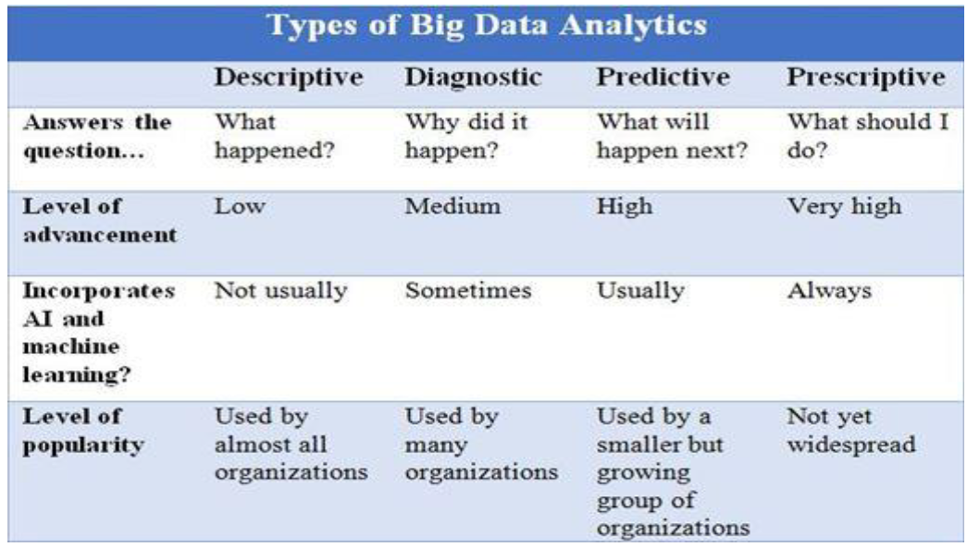
Descriptive, Predictive, and Prescriptive Analytics
The Three Levels of Analytical Insight Cont..

Slide 29
Applications and Skills for Business Analytics
Applications:
Business Applications: Fraud detection (Finance), risk modeling, supply chain optimization (Operations), customer segmentation (Marketing).
Text Analytics: Analyzing text data (reviews, emails) for insights like sentiment analysis.
Web Analytics: Measuring user activity on web properties (clicks, bounce rate) for optimization.
Text & Web Mining (Data Mining) is critical for unstructured data in the Big Data context, providing value from social media or web logs.

Slide 30
Applications and Skills for Business Analytics Cont..
Skills for Business Analytics (The Triad):
  Business Acumen/Domain Knowledge (Problem understanding). Simply means understanding how a business works and how it makes money. It’s about seeing the big picture—knowing what helps a company succeed, what customers want, and how to make smart choices for growth.
  Math/Statistics (Model building and testing).
  Computer Science/Programming (Data manipulation and tool usage).
The required skills are not isolated. Data professionals need to be T-shaped: deep in one area (e.g., programming, machine learning) but broad across others (statistics, communication, and business context). This hybrid approach allows managers to formulate and solve business problems effectively.

Slide 31
Concepts of Data Science and Required Basic Skills
Defining the Data Scientist
Concepts of Data Science: An interdisciplinary field combining statistics, computer science, and domain expertise to extract knowledge and insights from data.
Core Difference: Data Science is often focused on Predictive questions and unstructured data, whereas traditional BI focuses on Descriptive questions and structured data.
Basic Skills Required for Understanding Data Science:
  Strong Logic & Critical Thinking.
  Understanding of Probability and Statistics.
  Proficiency in at least one Programming Language (Python/R).
  Knowledge of Data Structures and Algorithms.

Slide 32
Concepts of Data Science and Required Basic Skills
Defining the Data Scientist Cont..
Data Science is the umbrella term for the most advanced analytical practices.
The skillset is demanding: it requires not just math or code, but the ability to translate a complex, messy real-world problem into a quantitative model and then back into a managerial recommendation.

